Slide 1

Calculus
Differentiation

Slide 2

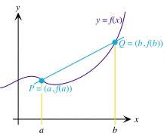
Average rate of change
The average rate of change of the function f over the interval [a, b] is
Average rate of change of f = =
= Slope of line through points P and Q in the figure
We also call this average rate of change the difference quotient of f over the interval [a, b].

Slide 3


Quick Examples
If f(3) = -1 tons. and f(5) = 0.5 tons, and if x is measured in years, then the average rate of change of f over the interval [3, 5] is given by
Average rate of change over [3, 5] =
=
= 0.75 tons per year

Slide 4



Instantaneous rate of change
The instantaneous rate of change of f(x) at x = a is defined by taking the limit of the average rates of change of f over the intervals [a, a+h], as h approaches 0. We write:
Instantaneous rate of change =
Instantaneous rate of change can be obtained by differentiating the equation of the curve and substituting the value of x.

Slide 5
Quick Example
You are based in Indonesia, and you monitor the value of the US Dollar on the foreign exchange market very closely during a rather active five-day period. Suppose you find that the value of one US Dollar can be well approximated by the function
R(t) = 7500 + 500t - 100t² rupiahs,
where t is time in days. (t = 0 represents the value of the Dollar at noon on Monday.)
Find the instantaneous rate of increase of the value of Dollar at noon on Tuesday.
R(t) = 7500 + 500t - 100t² rupiahs
R’(t) = 500 – 200t
R’(1) = 500 – 200(1)
= 300
The Dollar was increasing at an instantaneous rate of 300 rupiahs per day at noon on Tuesday

Slide 6
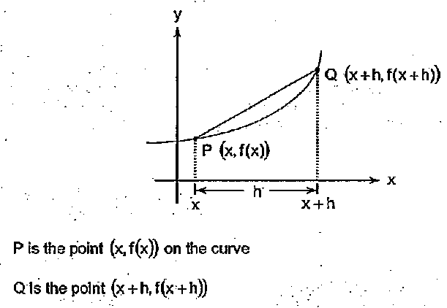
Differentiation

Slide 7
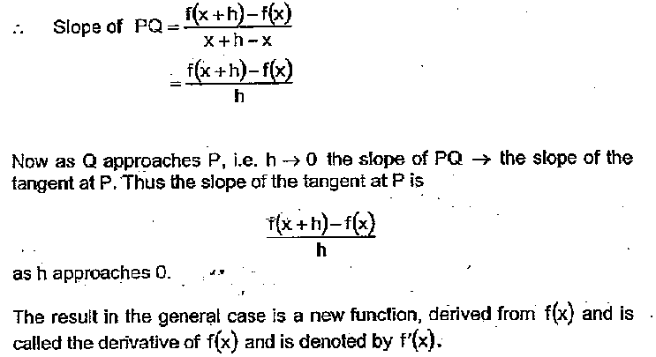
Differentiation

Slide 8
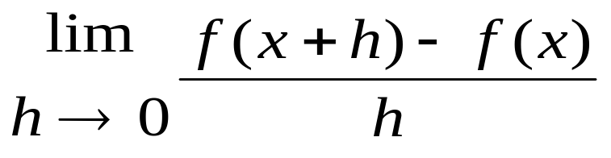
Differentiation
Hence, the gradient at P = f’(x) is:
This process of determining the gradient
formula or gradient function of a curve or
function is called DIFFERENTIATION

Slide 9
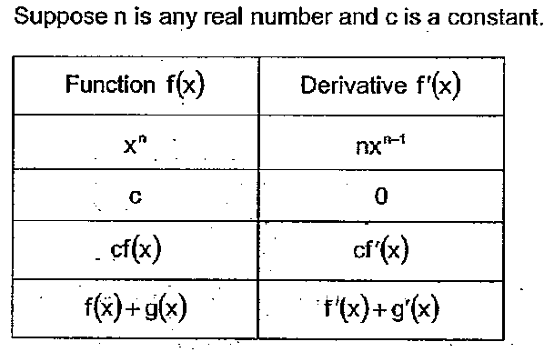
Formula of Differentiation

Slide 10
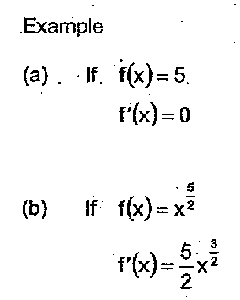
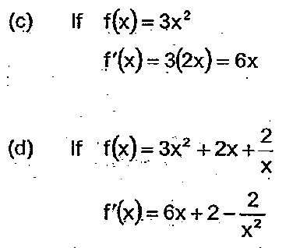
Differentiation

Slide 11
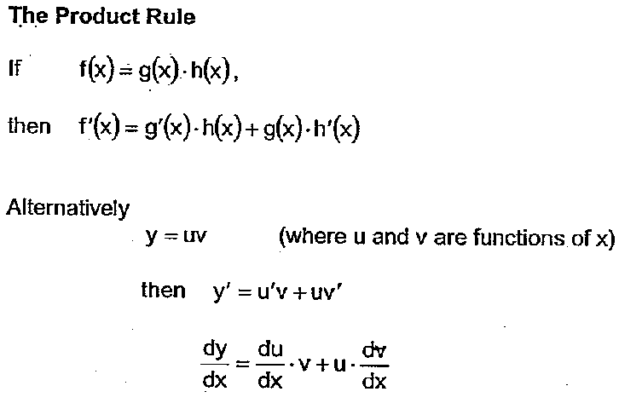
Differentiation (Product Rules)

Slide 12
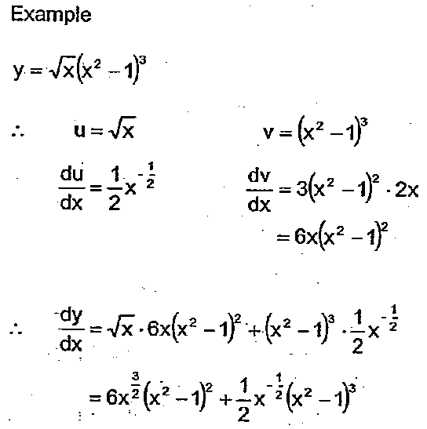

Slide 13
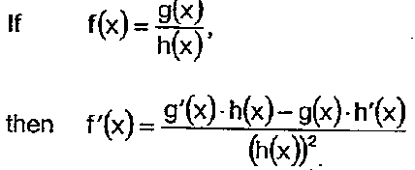
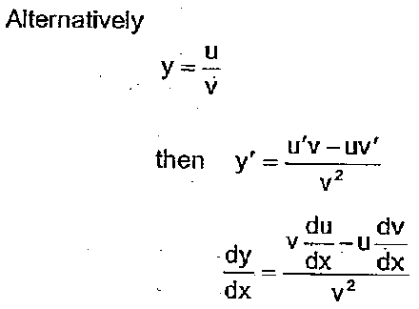
Differentiation (Quotient Rules)

Slide 14
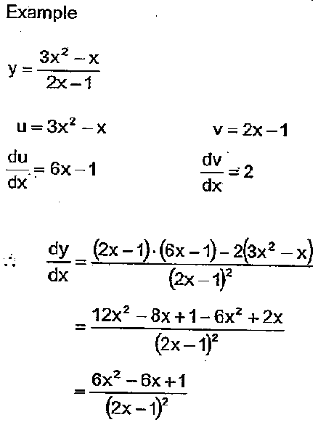

Slide 15
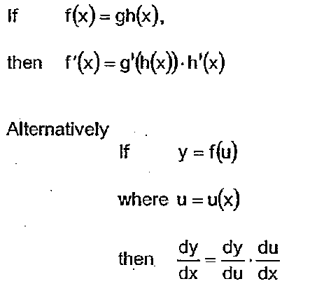
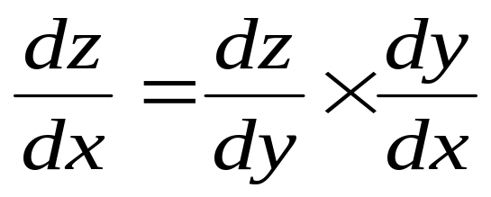
Differentiation (Chain Rule)
Leibniz Notation

Slide 16
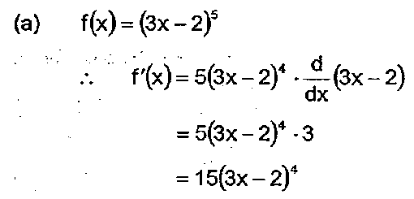
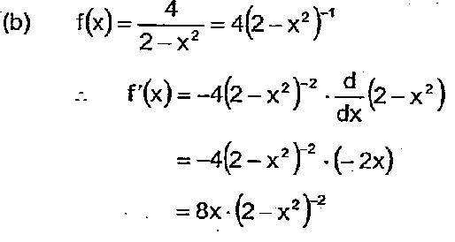
Example (Chain Rule)

Slide 17
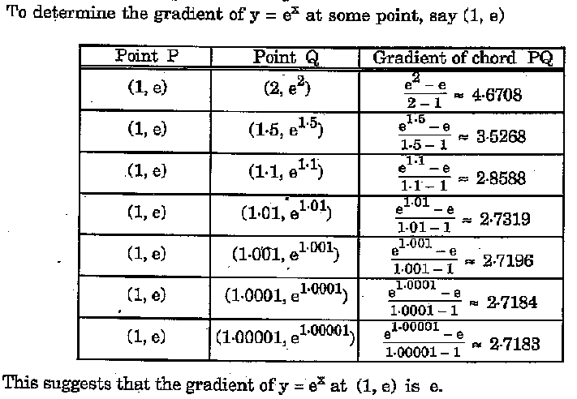
Differentiate exponential functions

Slide 18
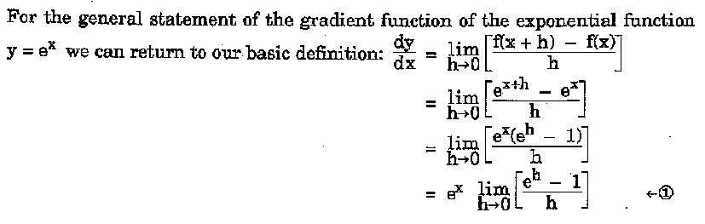
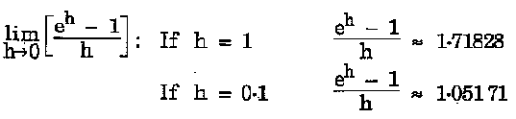
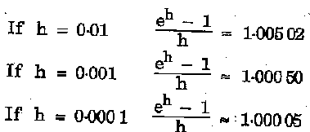
Differentiate exponential functions

Slide 19
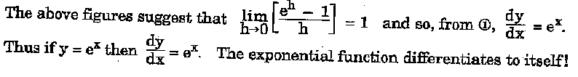
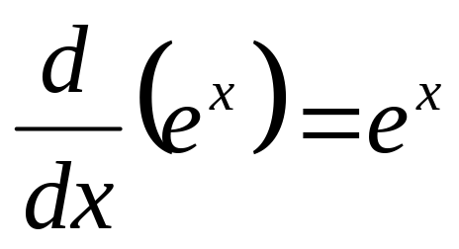
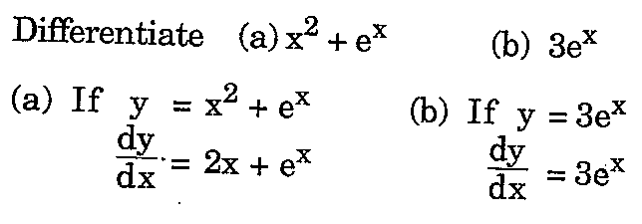
Differentiate exponential functions

Slide 20
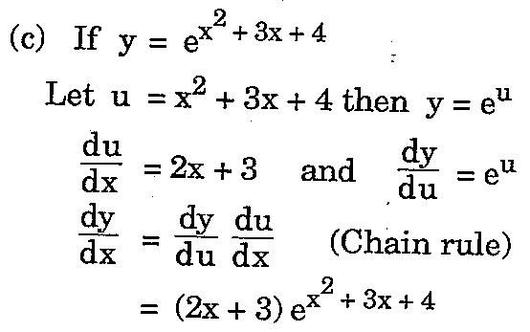
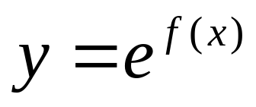
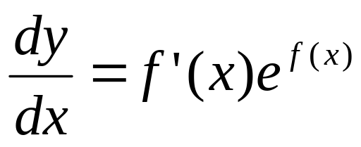
Differentiate exponential functions
From the example,
if
then, by the chain
rule

Slide 21
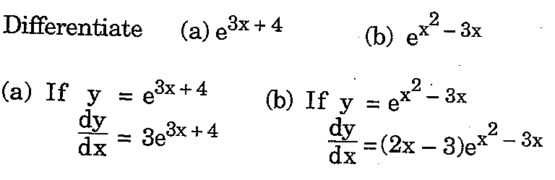
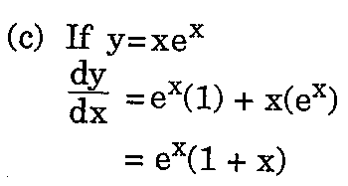
Differentiate exponential functions

Slide 22
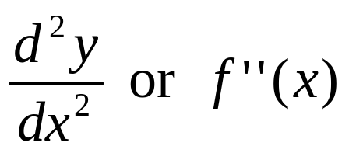
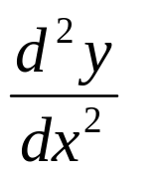

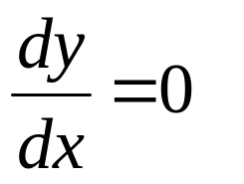
Differentiation
Second derivative
Two times differentiation of the function y
Second derivatives are used to determine the nature of the minimum or maximum value
If > 0 : minimum , if < 0 : maximum
Optimisation problems:
minimum and maximum -->

